Slide 1
RESUME GENERATOR

Slide 2
Problem Statement
Develop a PHP-based system that generates professional resumes dynamically based on user inputs and preferences. The system should allow users to input their personal and professional information, select a template, and generate a well-formatted resume document in various formats.

Slide 3


Team Members
Dincy Daniel
Software Engineer
Sulaksh Sharma
Software Engineer

Slide 4
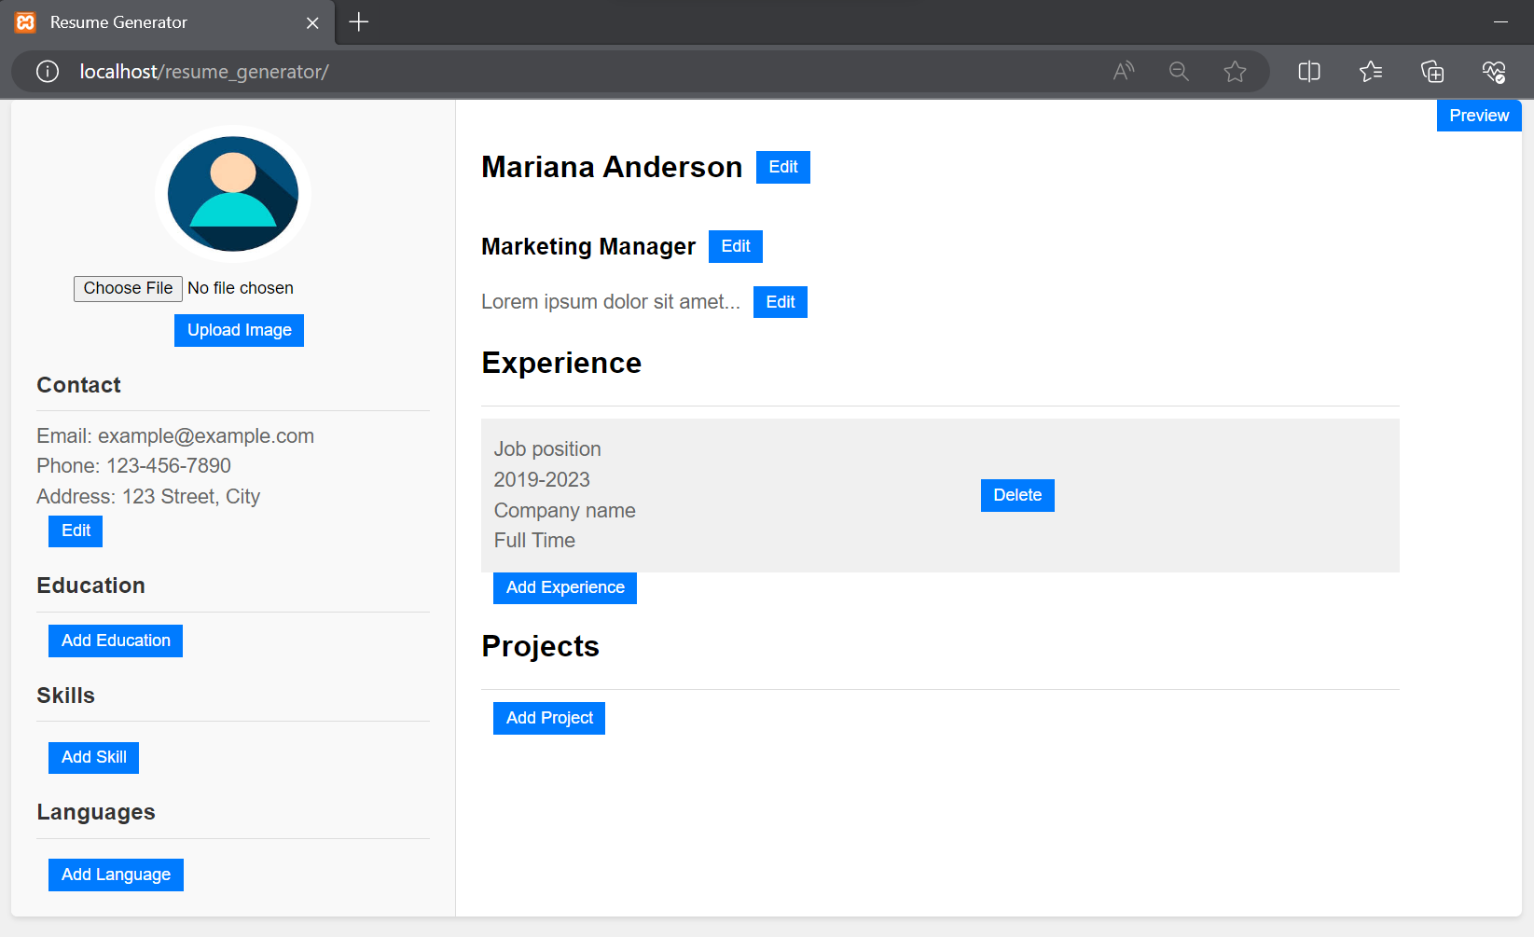
Initial Layout:

Slide 5
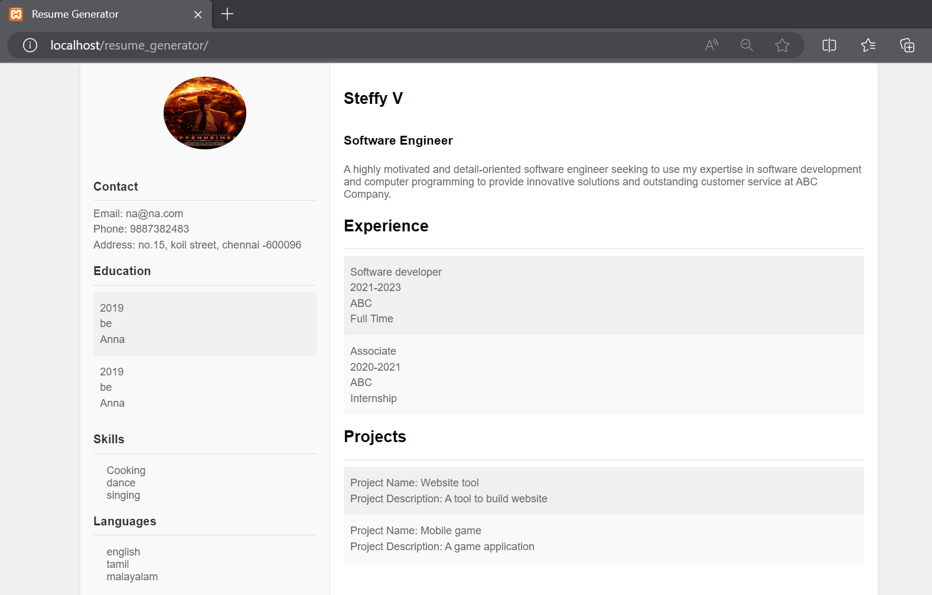
Result:

Slide 6
Project Overview
We have created multiple components on our webpage which highlights the basic information, skills and projects which the user can edit and save. These include:
Profile Picture Upload
Contact Details
Education Section
Skills Showcase
Work Experience
Project Portfolio
Language Proficiency
Resume Generation (Preview)

Slide 7
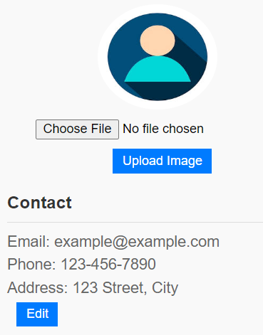
Key Features
1. Profile Picture Upload:
Users can upload their profile pictures for a personal touch.
A professional photo enhances the visual appeal of the resume.
2. Contact Details:
Easy-to-use interface to input and update contact information.
Users can include email, phone number, and address details.

Slide 8
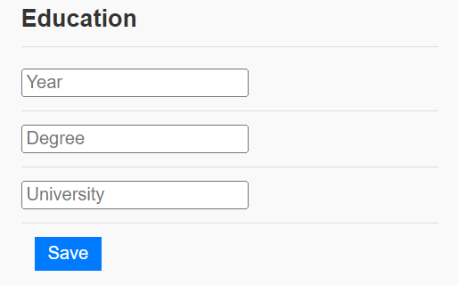
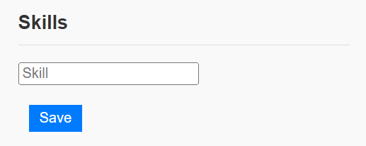
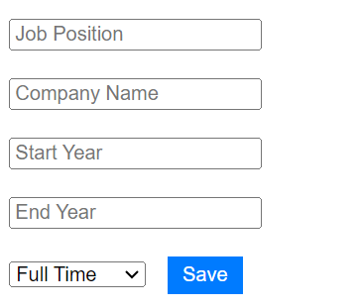
Key Features (Conti…)
3. Education Section:
Add details about academic achievements and qualifications.
Mention institutions, degrees earned, and graduation years.
4. Skills Showcase:
Display a list of skills and areas of expertise.
Update and tailor skills based on the job requirements.
5. Work Experience:
Highlight professional experiences, job positions, and companies.
Mention employment duration and responsibilities.

Slide 9
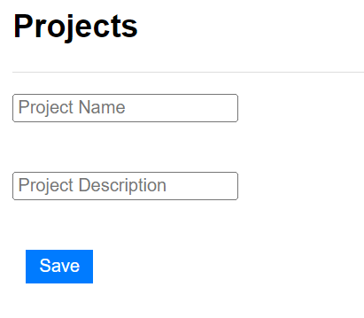
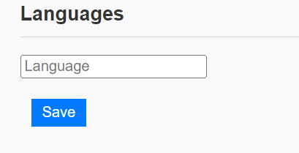
Key Features (Conti…)
6. Project Portfolio:
Showcase completed projects with their descriptions.
Illustrate technical skills and accomplishments.
7. Language Proficiency:
List languages spoken or programming languages known.
Reflect language skills relevant to job opportunities.

Slide 10
Key Features (Conti…)
9.User-friendly Interface:
Intuitive design for a smooth user experience.
Clear sections and input fields for easy data entry.
10. Accessibility:
Access and edit the resume from anywhere with an internet connection.
Compatible with various devices and screen sizes.
11. Real-time Preview:
See the changes in real time while editing the resume.
Ensure accuracy before generating the final version.

Slide 11
Code Explanation
So here we have used three php files i.e :
index.php : Contains the entire HTML template, CSS code and conditional rendering of the sections with the help of PHP.
preview_resume.php : In this, it includes the rendering logic from our original index.php file.
render_preview.php : All the details would be rendered on the page disabling the button functionality.
sessions.php : The session variables are stored here and the post data that we are fetching would be assigned to our session variables and the backend logic works here….

Slide 12
Thank You !

